Slide 1
Market Expansion
Legislation (Int 2263-2021, Int 2263-2021) was passed in November 2021 that required an SSM/Qualified Safety Professional on construction jobs 7 stories and higher.
To expand TSC’s market for potential clients, construction Jobs 7-9 stories high are now included in the total job market for potential clients, which prior to the legislation, included jobs 10 stories and higher only.

Slide 2




Dataset
We analyzed the DOB Job Application Filings Database hosted on the NYC Open Data website.
The dataset contains 1.78 million rows distinguished by 96 columns including Number of Stories, Permit Status, and Job Type.
The tools used to extract, analyze, and visualize the data were Python, Jupyter, and Tableau.
After data cleaning for 2019-2021 the number of rows is 697 and number of columns is 33.

Slide 3
Results 2019-2021
There were a total of 697 fully permitted jobs designated as new buildings ("NB")
267 of those jobs were 10 stories or higher
430 of those jobs were between 7 and 9 stories high.
Market increase ~ 161%

Slide 4
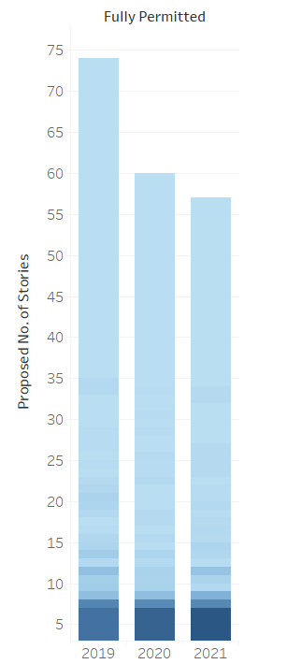

Slide 5
Results 2019
There were a total of 248 fully permitted jobs designated as new buildings ("NB")
115 of those jobs were 10 stories or higher
133 of those jobs were between 7 and 9 stories high.
Market increase ~ 116%

Slide 6
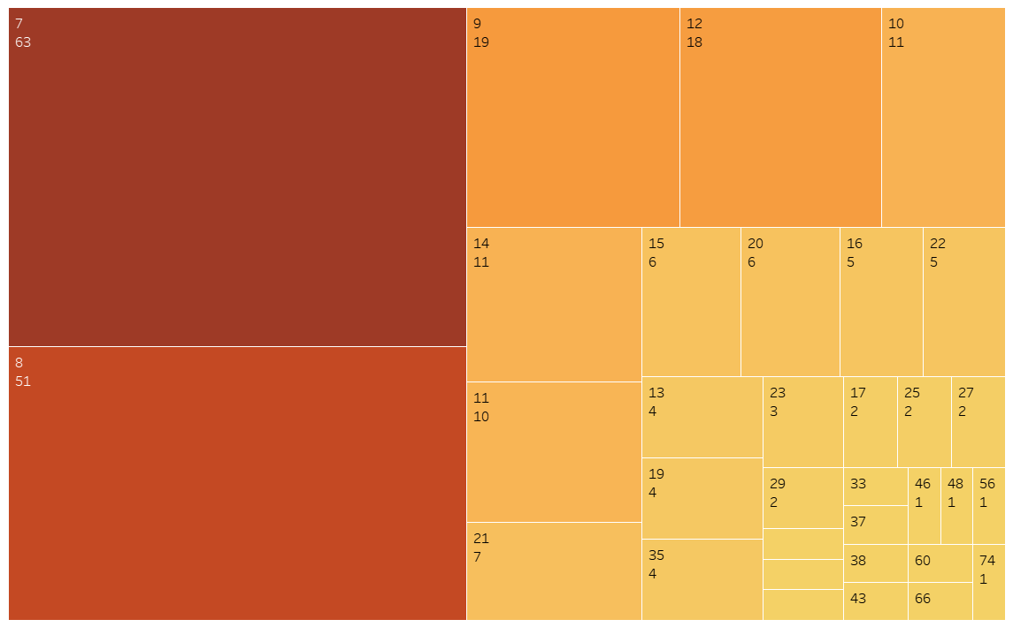

Slide 7
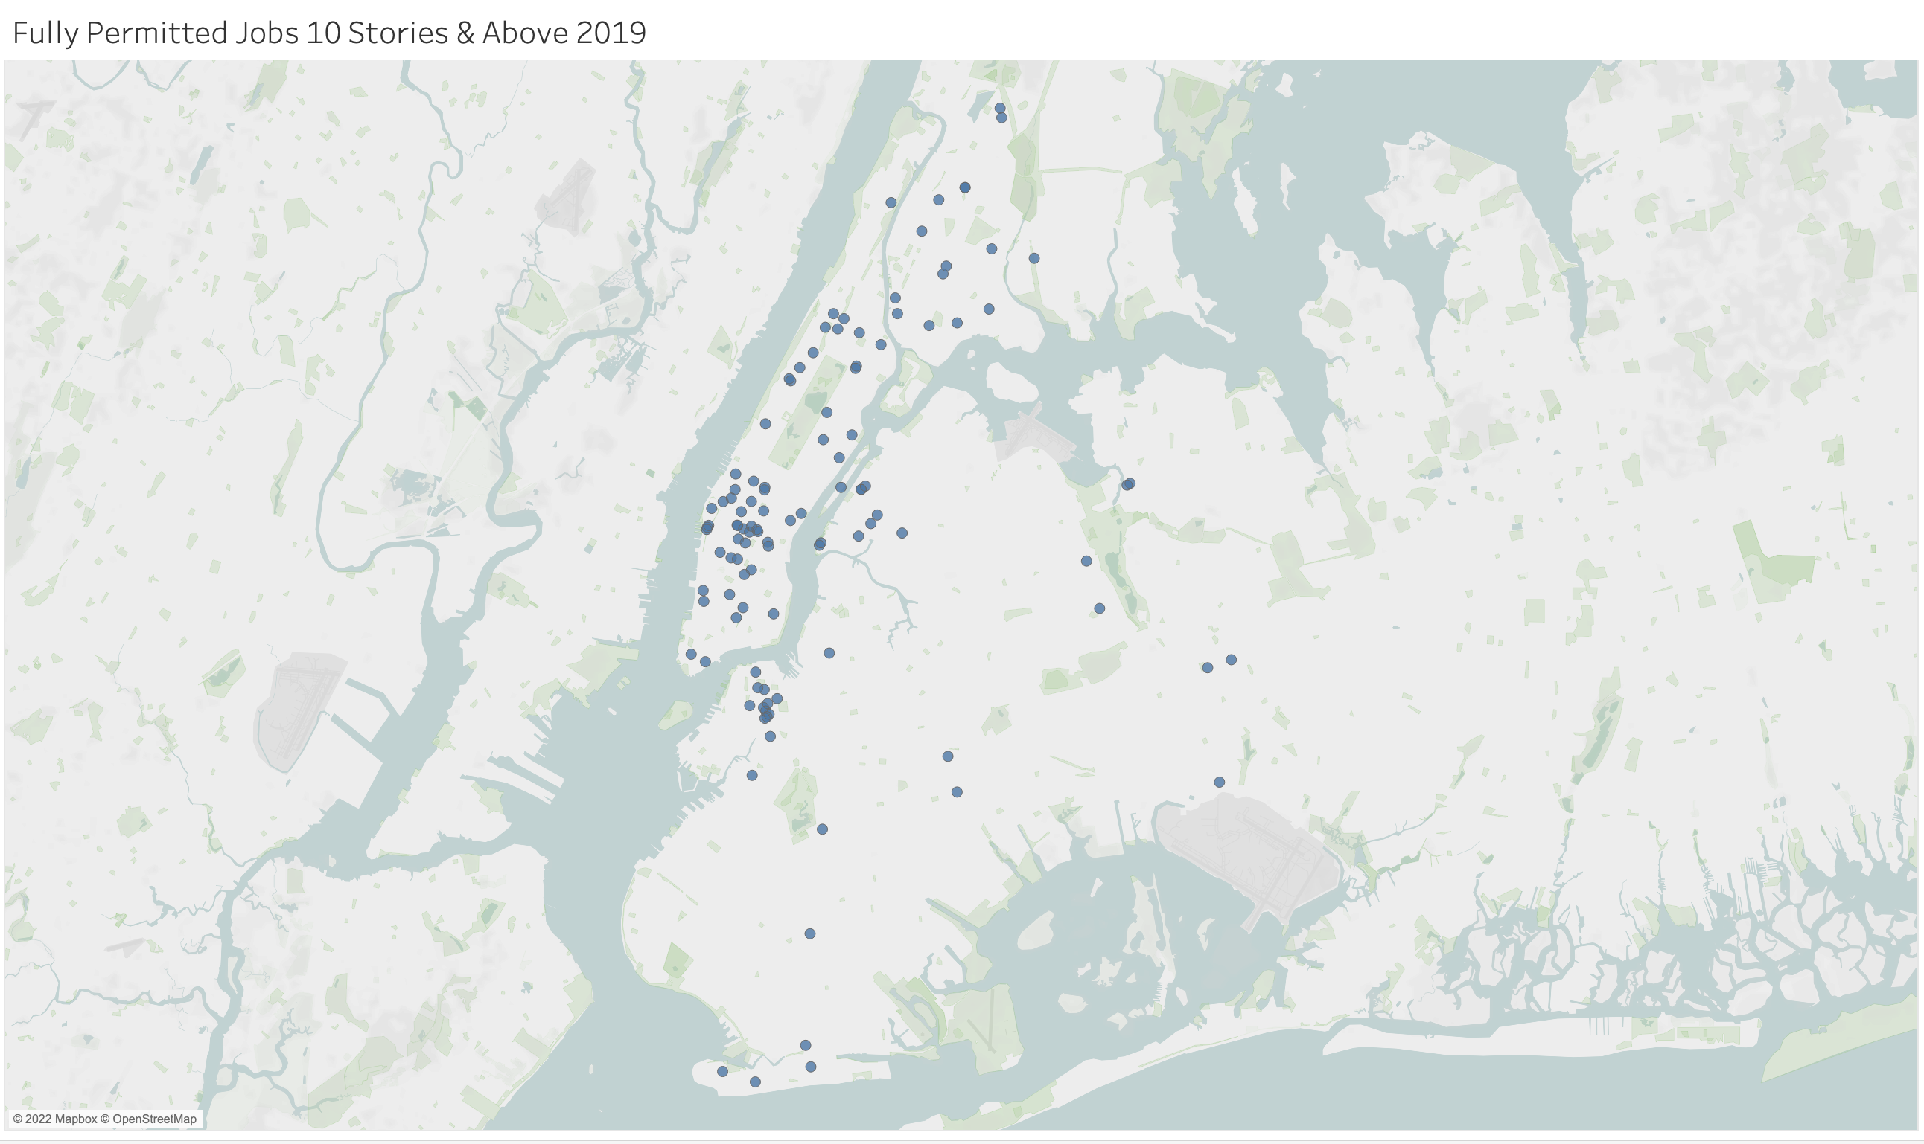

Slide 8
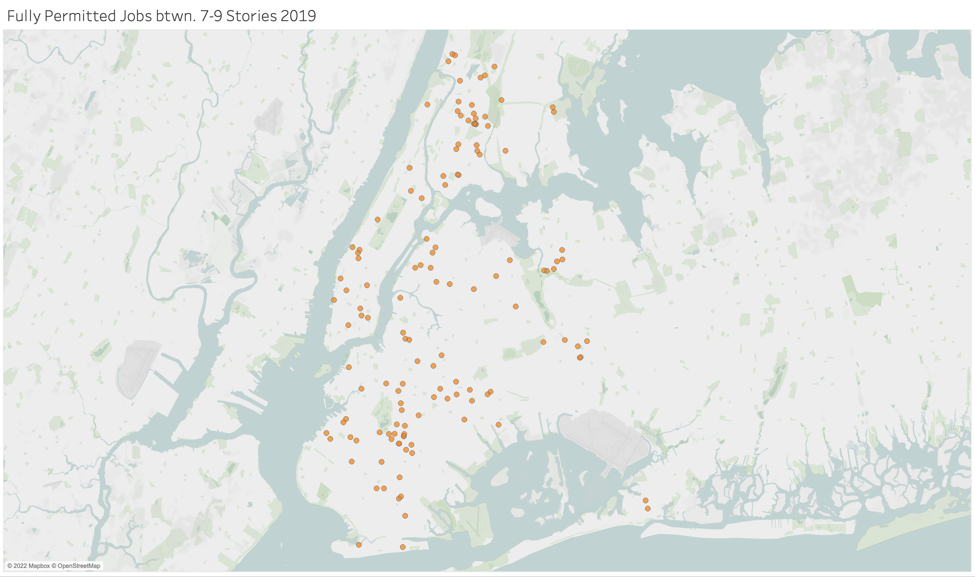

Slide 9
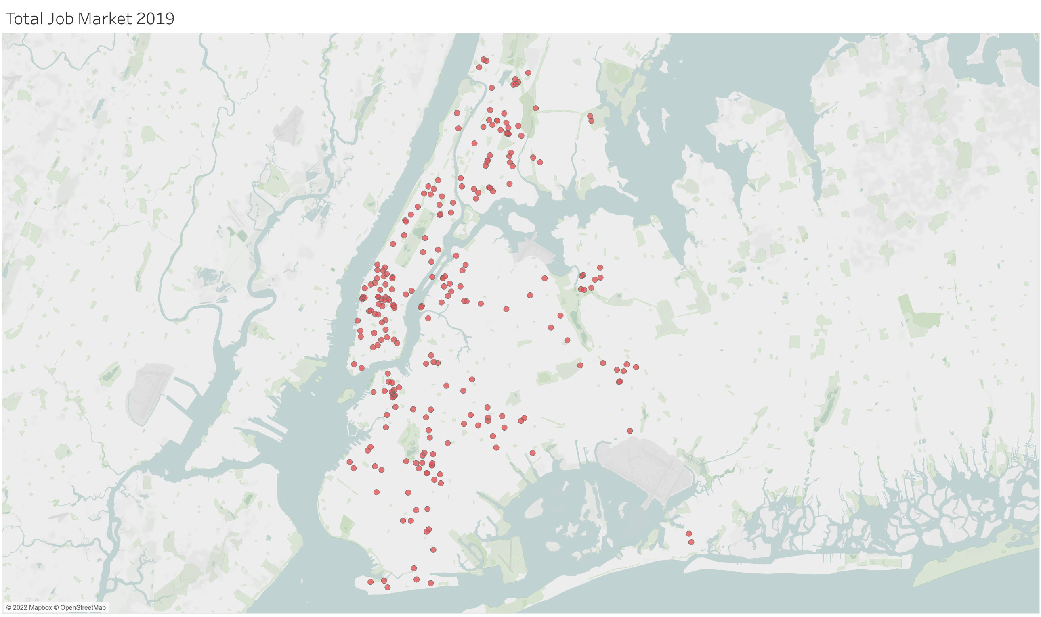

Slide 10
Results 2020
There were a total of 218 fully permitted jobs designated as new buildings ("NB")
77 of those jobs were 10 stories or higher
141 of those jobs were between 7 and 9 stories high.
Market increase ~183%

Slide 11
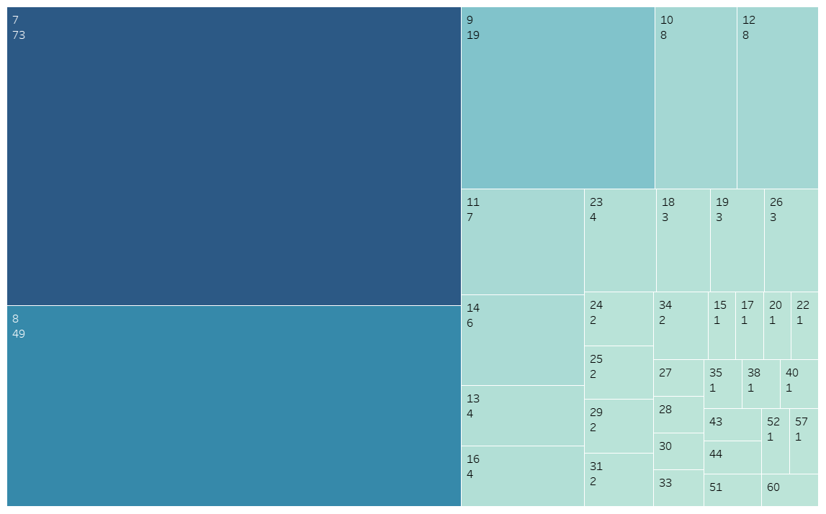

Slide 12
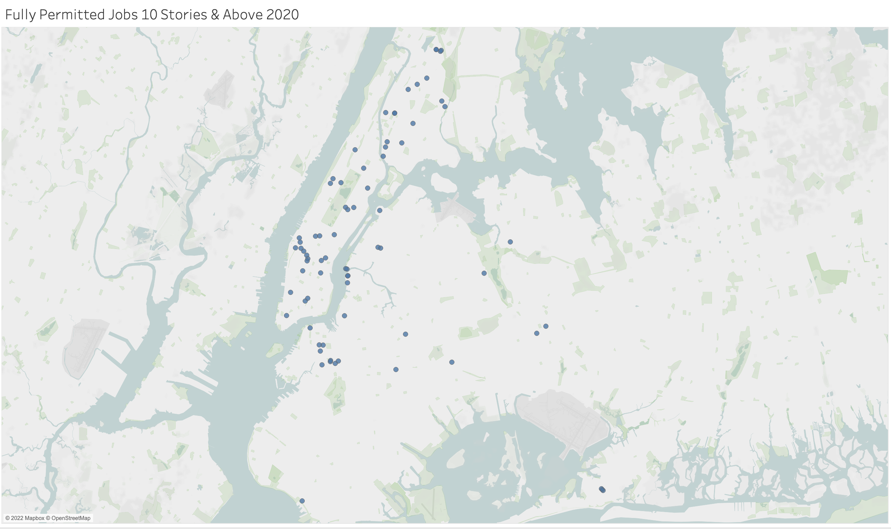

Slide 13
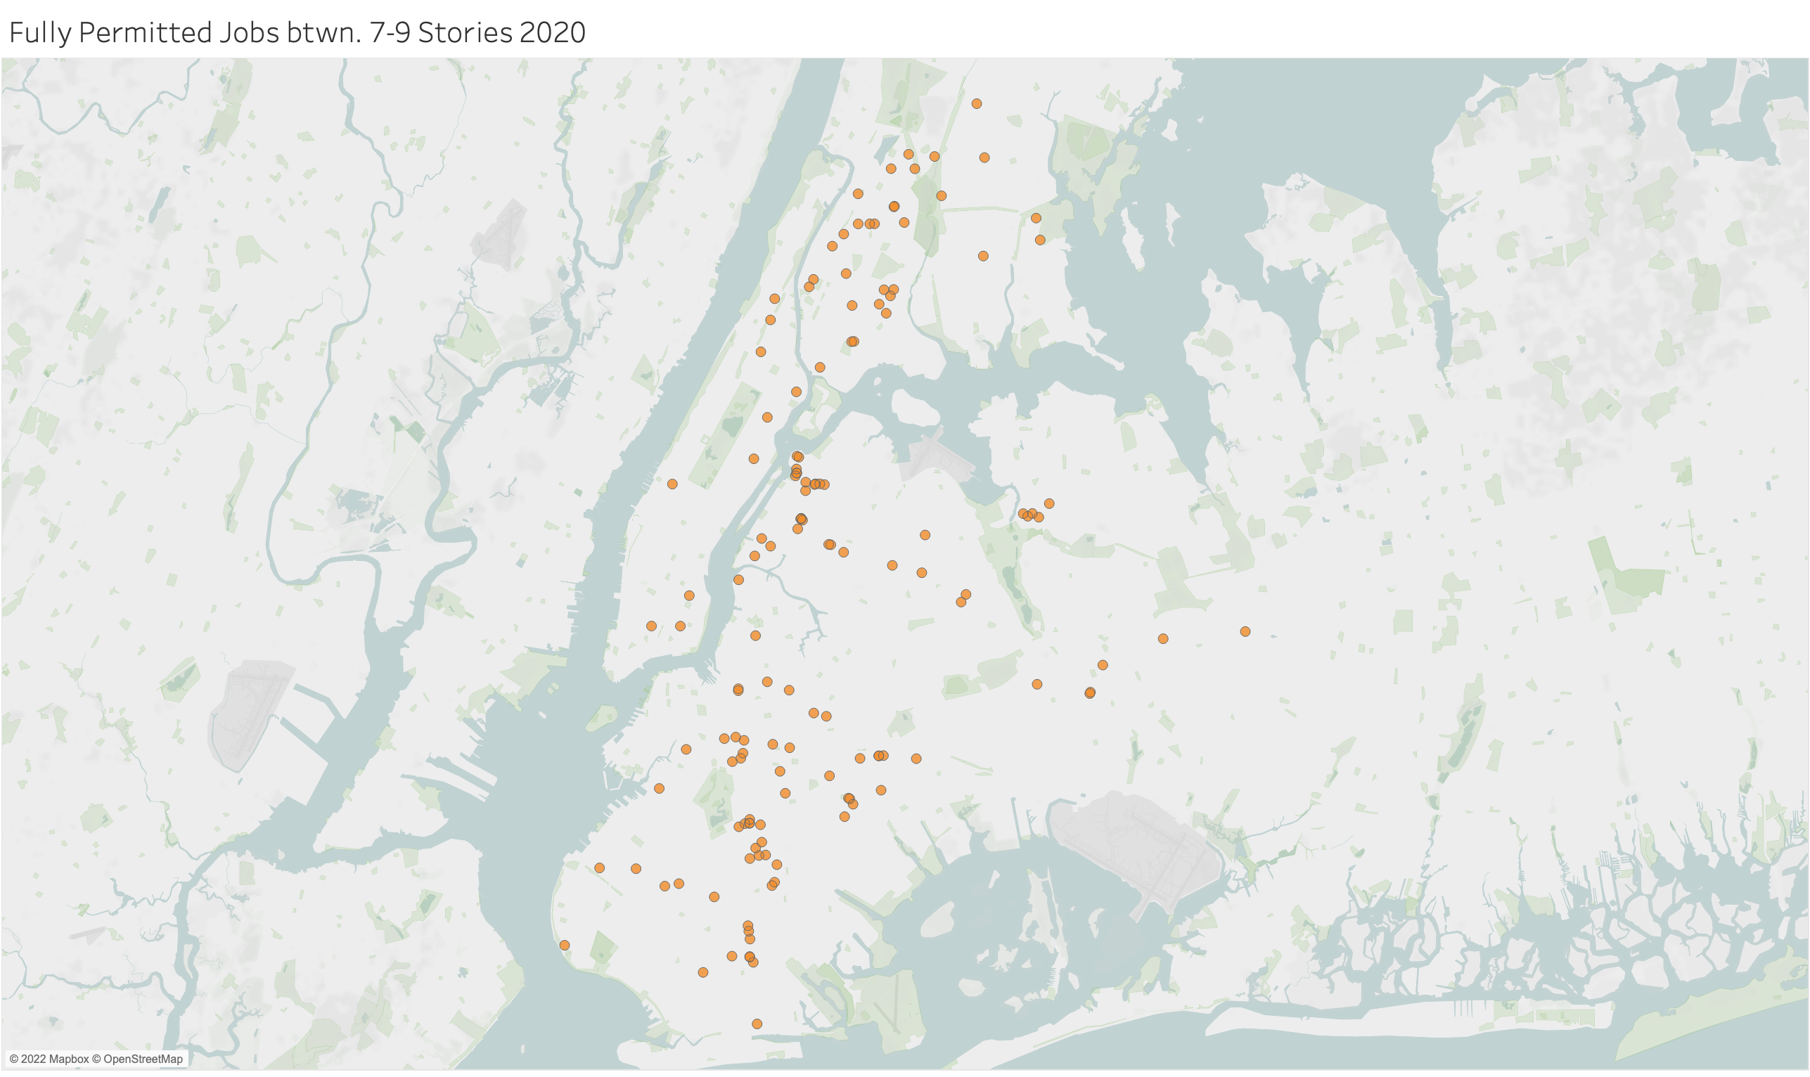

Slide 14
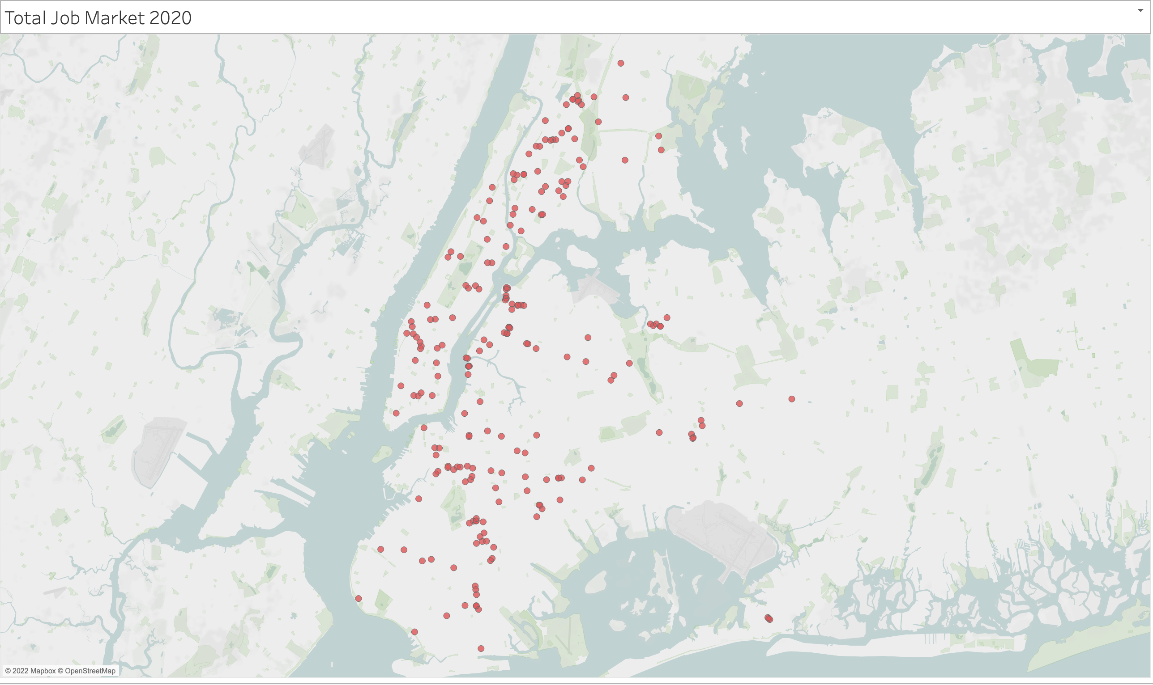

Slide 15
Results 2021
There were a total of 231 fully permitted jobs designated as new buildings ("NB")
75 of those jobs were 10 stories or higher
156 of those jobs were between 7 and 9 stories high.
Market increase ~208%

Slide 16
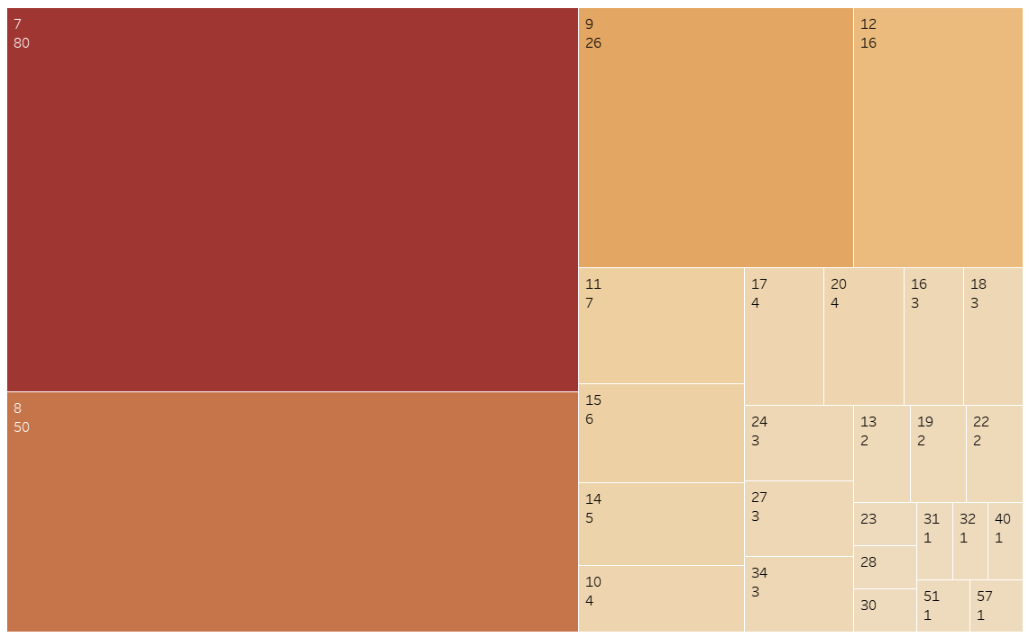

Slide 17
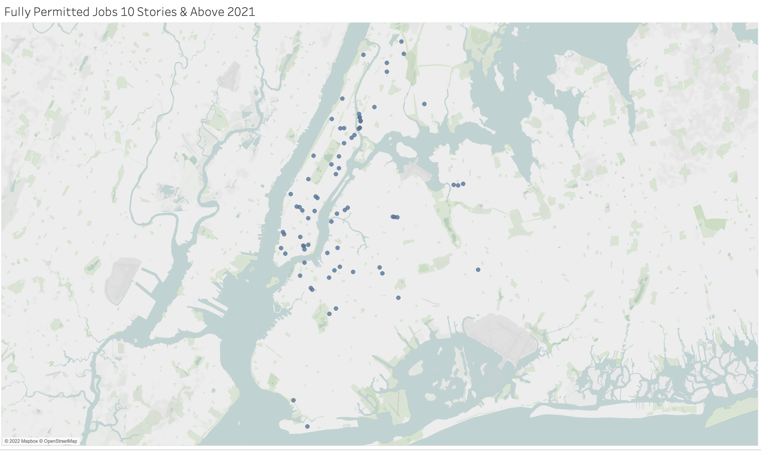

Slide 18
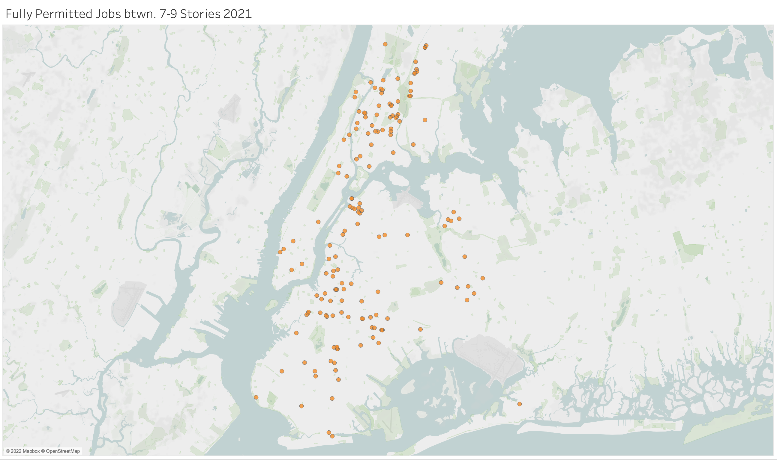

Slide 19
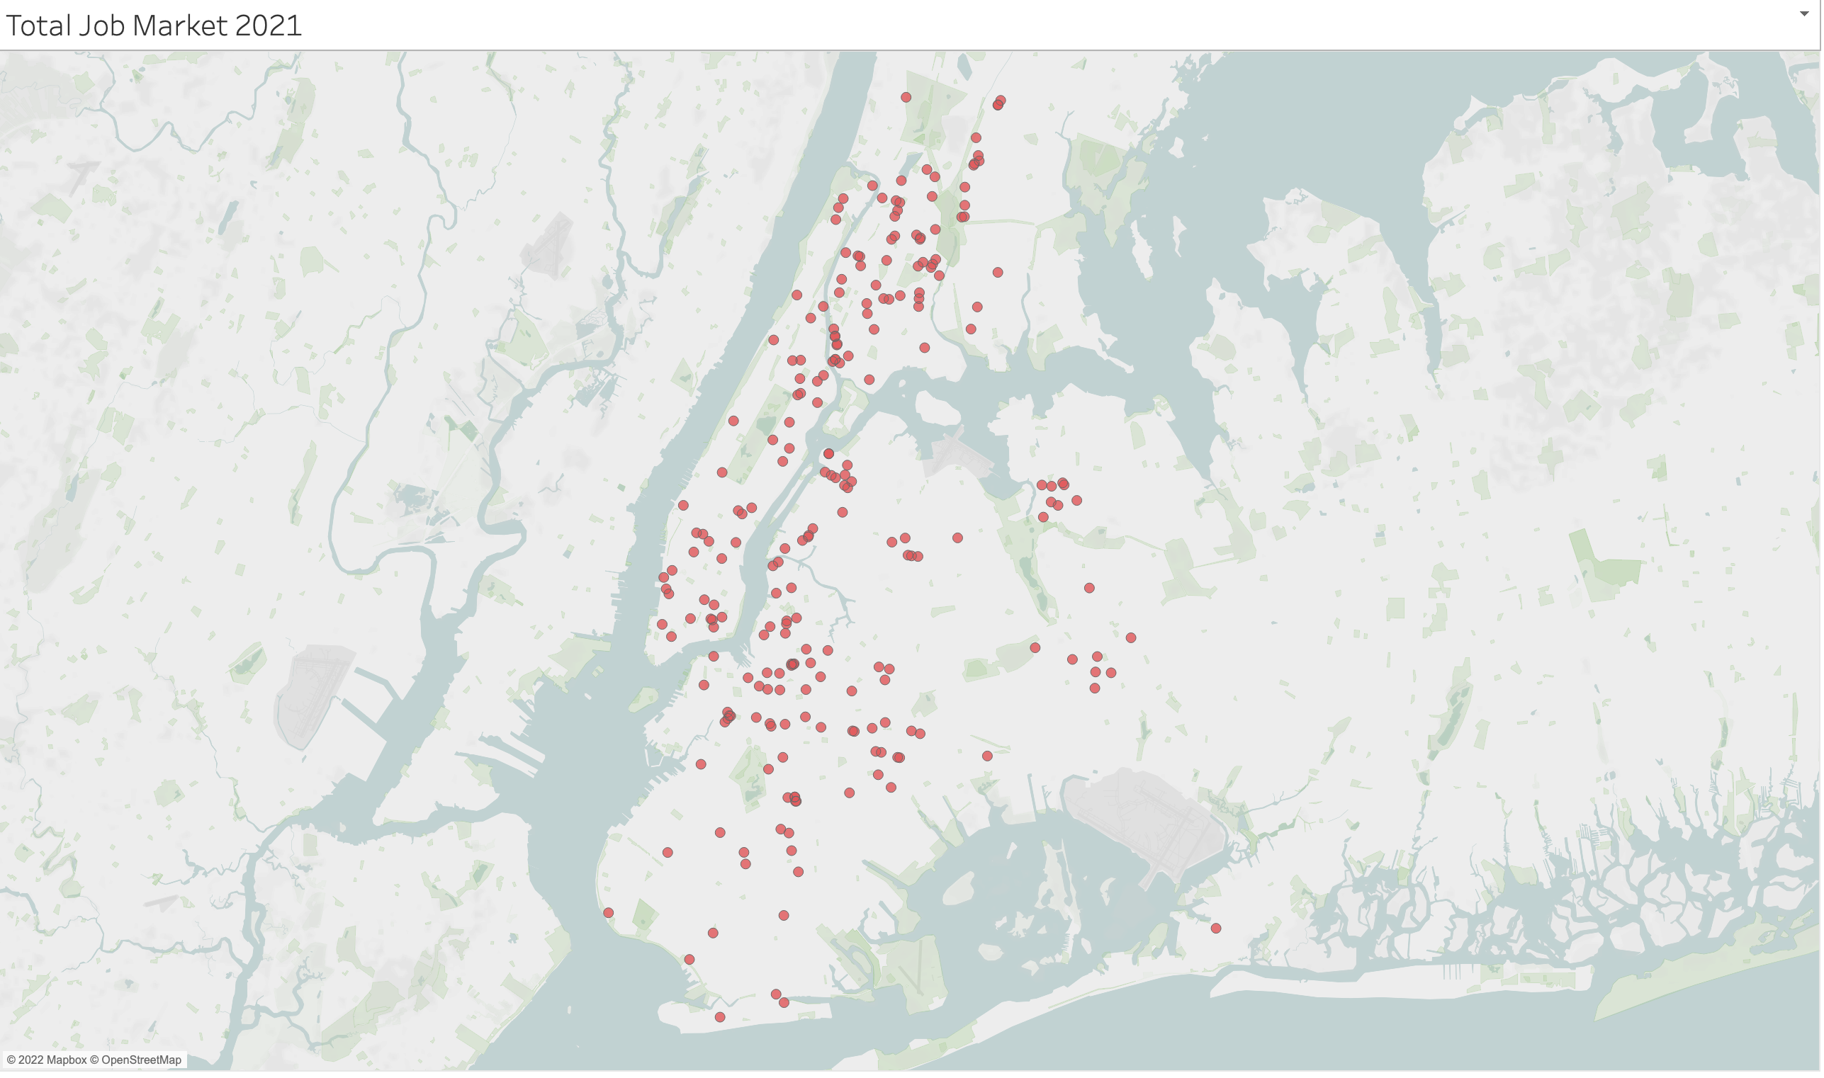

Slide 20
Future Works
The next steps would be to use this data for marketing purposes.
This process can be automated using Python.
A machine learning algorithm can be applied to the current dataset as far back or recent in time as deemed appropriate.
The algorithm can be trained on the characteristics desired for a typical potential client.
Once the algorithm is tuned and performing at high accuracy:
Python would interact with a live updated version of the dataset whenever the program is utilized.
The algorithm would sort through and round-up instances that meet our designated criteria.
Once that data is collected, an automated marketing email can be sent to the corresponding potential client.
This can all be created through Python and increase the exposure to this new pool of potential clients much more efficiently that by hand.

